Slide 1
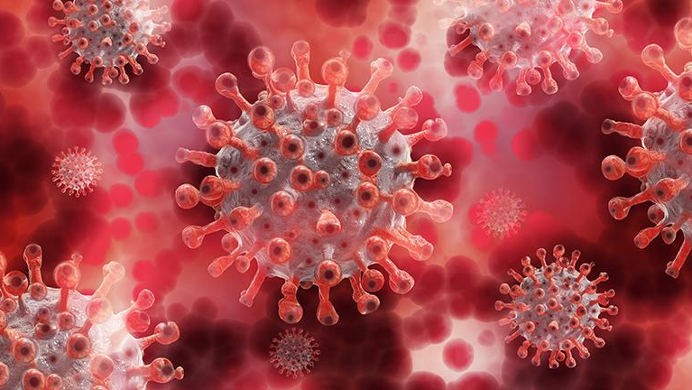
Covid 19
Novel Coronavirus (2019-nCoV)

Slide 2

Team member
Randa Adel
Reham Refaat
Aliaa Yaseen
Amira Hussien
Randa Sabry
Rania Soltan
UNDER SUPERVISION OF
Dr\ Majid Ahmed Jad Askar

Slide 3

About Data
From World Health Organization - On 31 December 2019, WHO was alerted to several cases of pneumonia in Wuhan City, Hubei Province of China. The virus did not match any other known virus. This raised concern because when a virus is new, we do not know how it affects people.
So daily level information on the affected people can give some interesting insights when it is made available to the broader data science community.

Slide 4

Covid 19
2019 Novel Coronavirus (2019-nCoV) is a virus (more specifically, a coronavirus) identified as the cause of an outbreak of respiratory illness first detected in Wuhan, China. Early on, many of the patients in the outbreak in Wuhan, China reportedly had some link to a large seafood and animal market, suggesting animal-to-person spread. However, a growing number of patients reportedly have not had exposure to animal markets, indicating person-to-person spread is occurring. At this time, it’s unclear how easily or sustainably this virus is spreading among people - CDC
This dataset has daily level information on the number of affected cases, deaths and recovery from 2019 novel coronavirus. Please note that this is a time series data and so the number of cases on any given day is the cumulative number.
The data is available from 22 Jan, 2020.

Slide 5
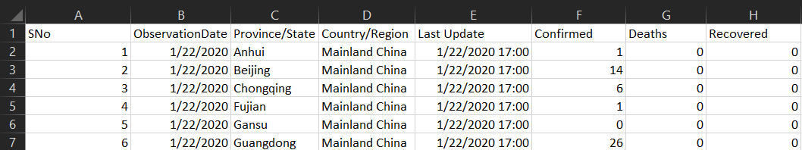
Column Description
The main file in this dataset is covid_19_data.csv with 8 columns and 306429 rows and the detailed descriptions are below.
• Sno - Serial number
• ObservationDate - Date of the observation in MM/DD/YYYY
• Province/State - Province or state of the observation (Could be empty when missing)
• Country/Region - Country of observation
• Last Update - Time in UTC at which the row is updated for the given province or country.
• Confirmed - Cumulative number of confirmed cases till that date
• Deaths - Cumulative number of deaths till that date
• Recovered - Cumulative number of recovered cases till that date

Slide 6

Cleaning Data using OpenRefine

Slide 7
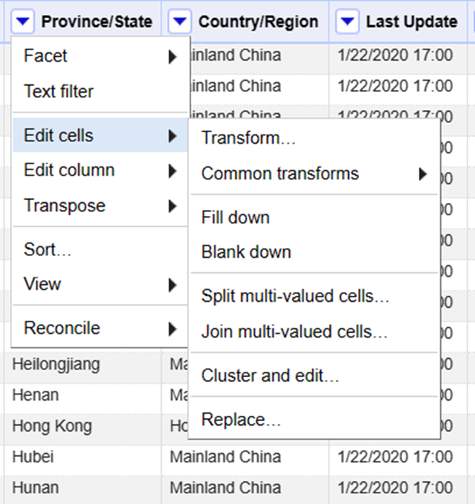
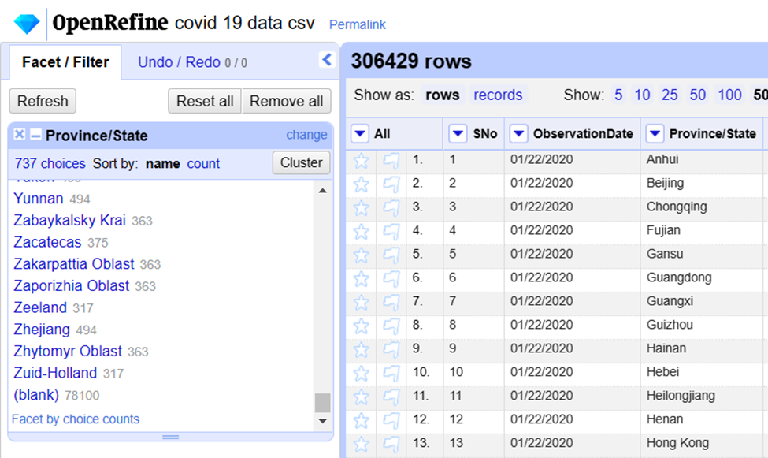
Process 1
Here, we find 78100 blanks in Province/State column, so we need to fill blanks by "Transform"

Slide 8
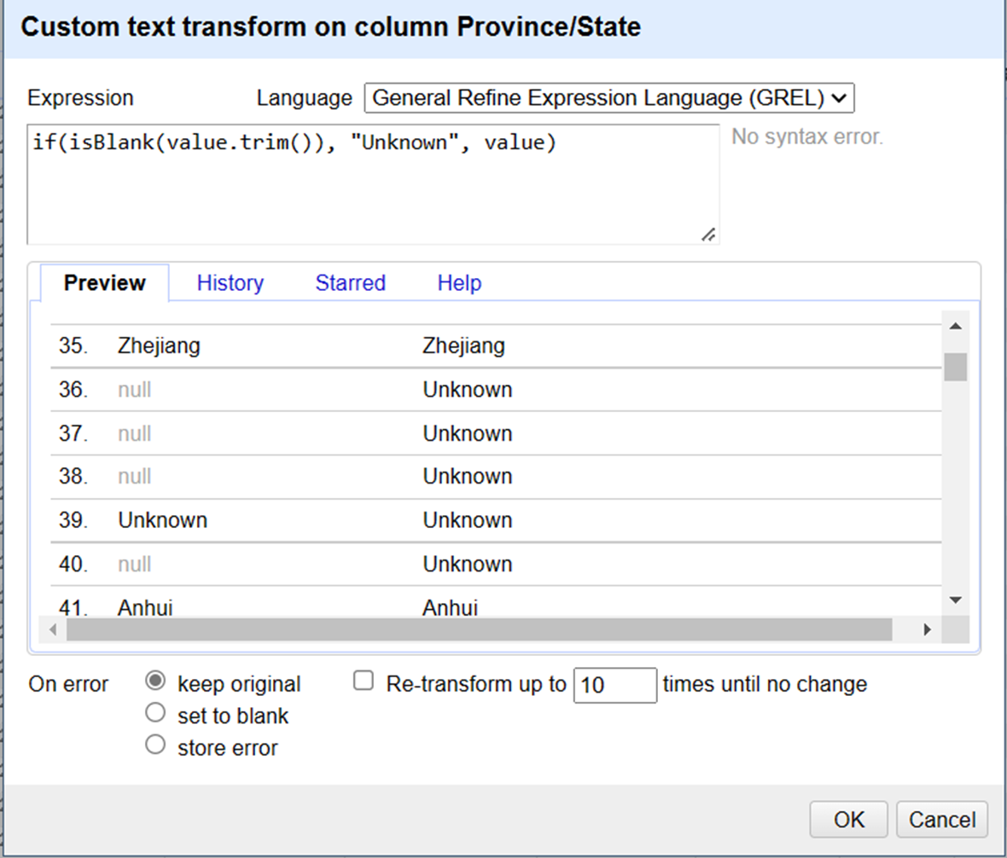
Process 1
In this condition, we search for any null value and replace it with an "Unknown" value

Slide 9
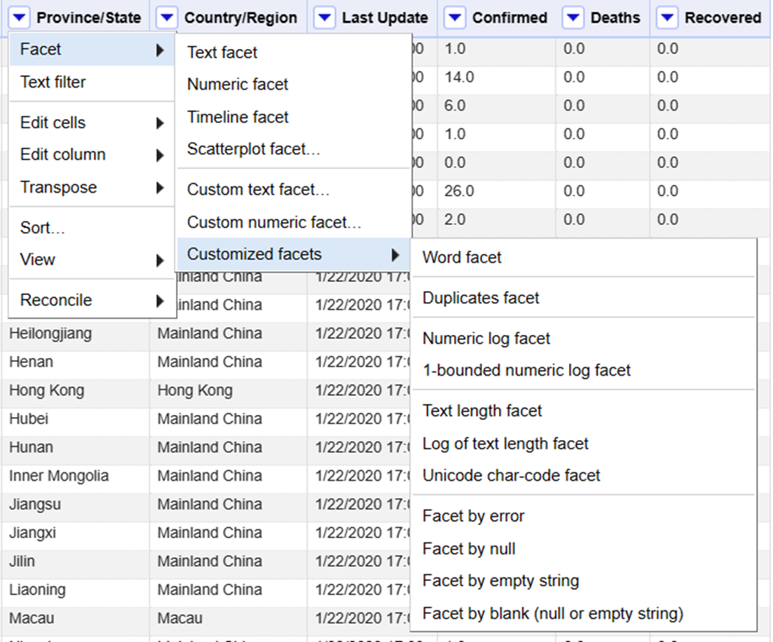
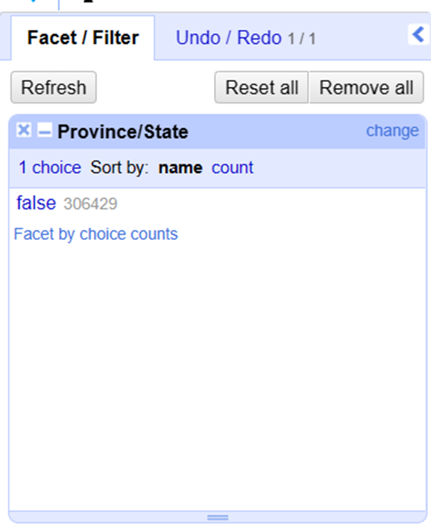
Process 1 Test
We just test that blanks are removed

Slide 10
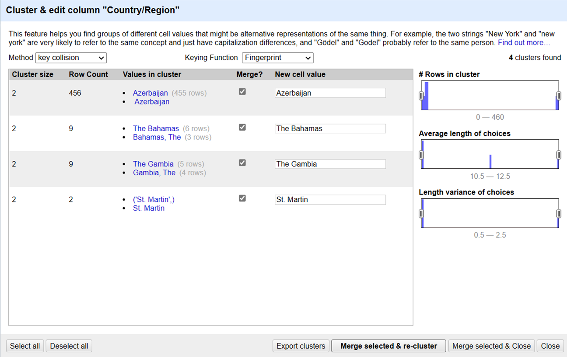
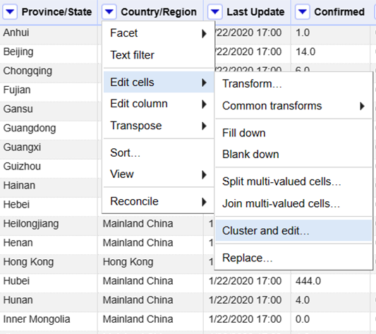
Process 2
Then, we cluster and edit in Province/State column.
We discover that there are 4 errors.

Slide 11
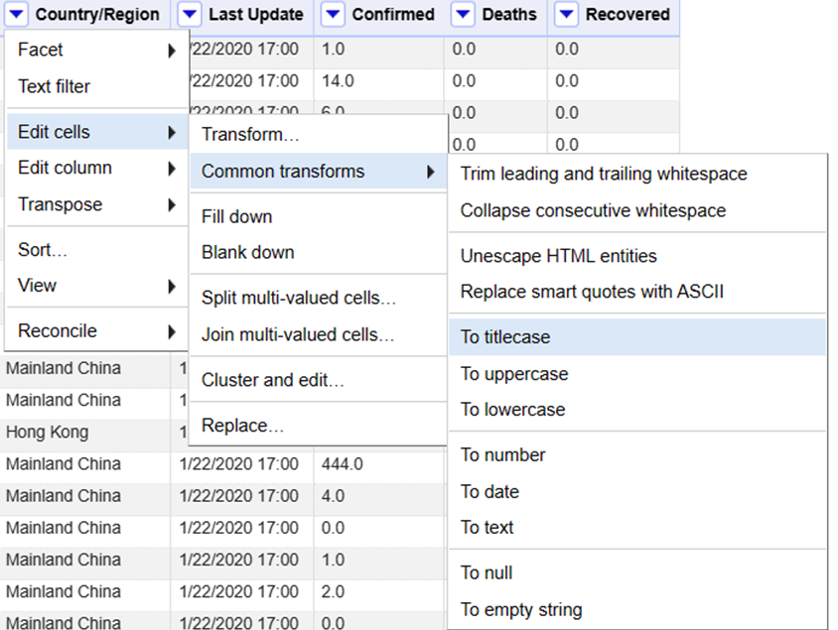
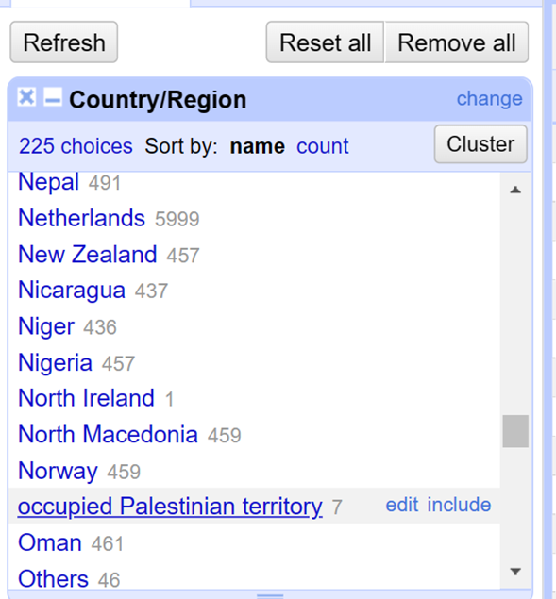
Process 3
In some countries we find it written in small capital letters, so that we will adjust it to the title case

Slide 12
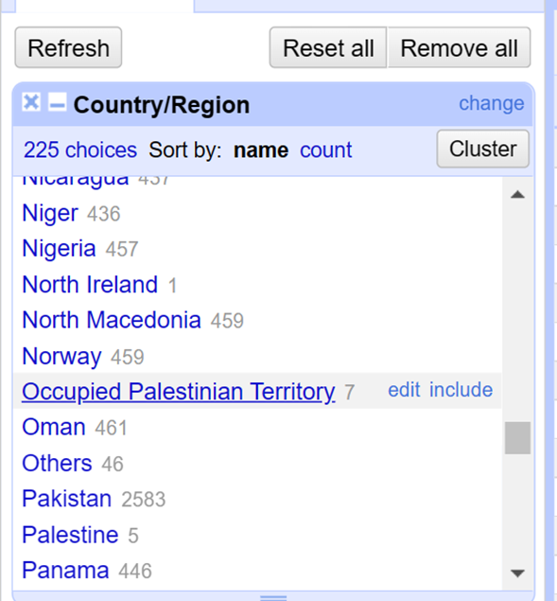
Process 3 result

Slide 13
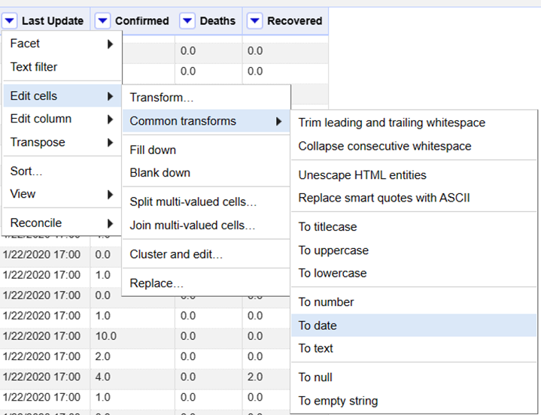
Process 4
In this data,
the date format is not unified, so the formula must be unified

Slide 14
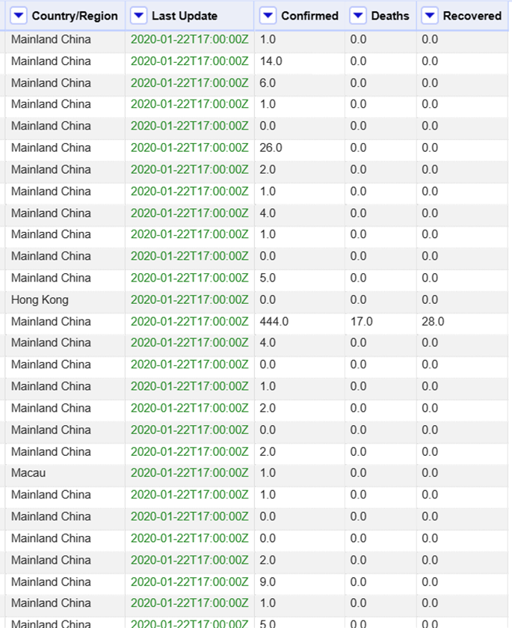
Process 4 result

Slide 15
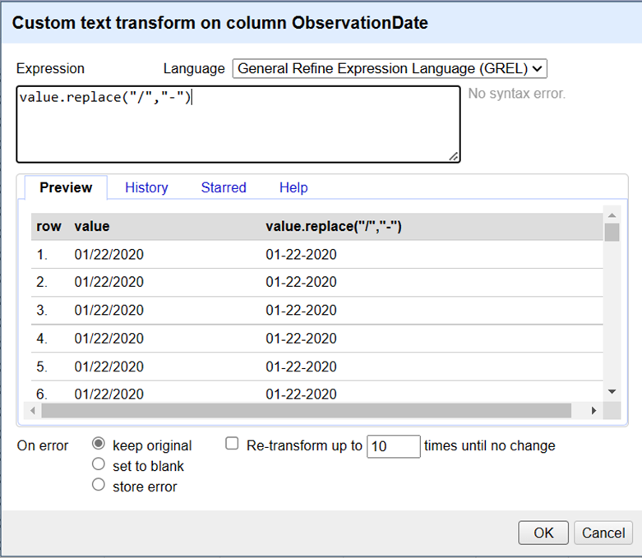
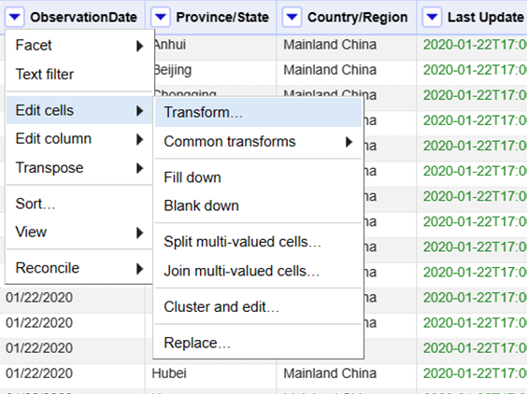
Process 5
The R language cannot recognize the date in this format "01/22/2020"
, so we will replace it with this format "01-22-2020"

Slide 16
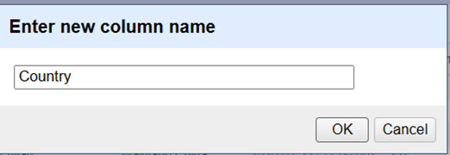
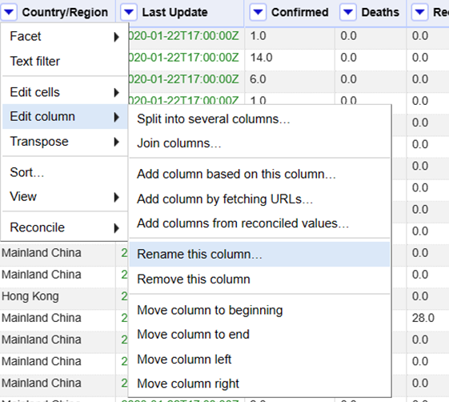
Process 6
We rename Country/State column

Slide 17
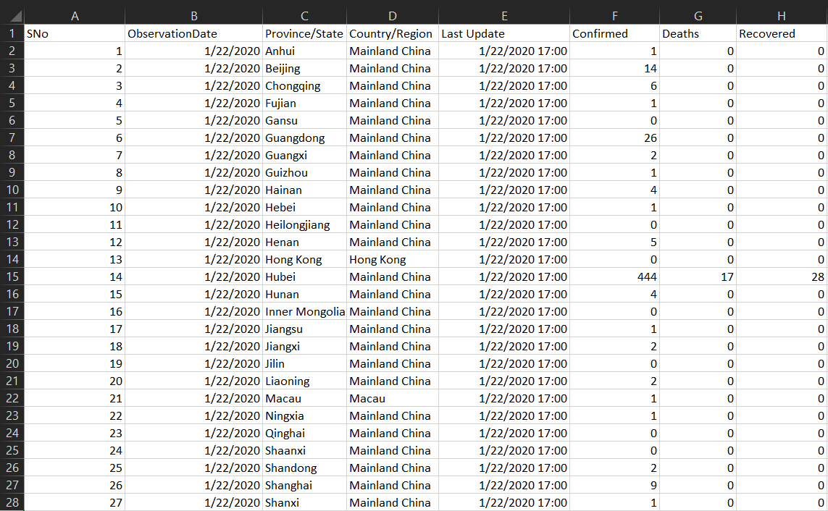
Finally, we have clean data

Slide 18

Visualization in R

Slide 19
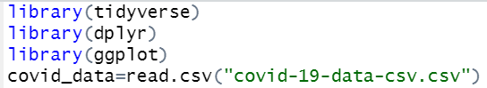
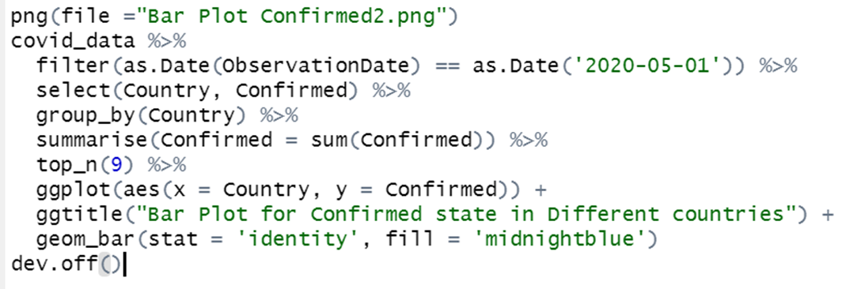
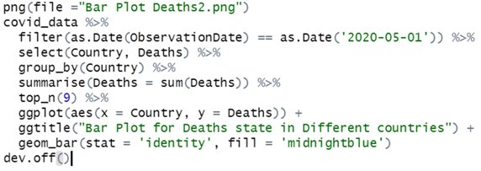
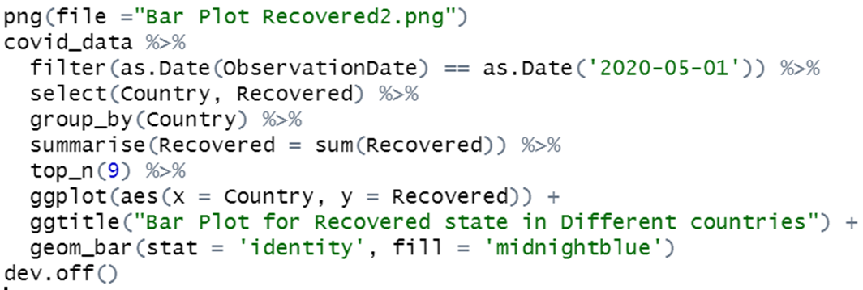
Bar Plot 1

Slide 20
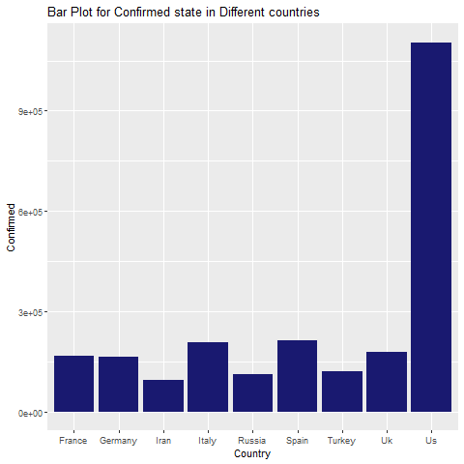
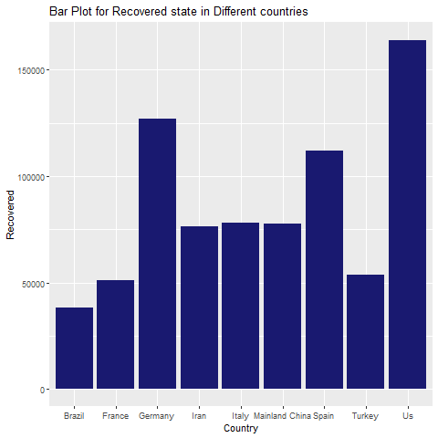
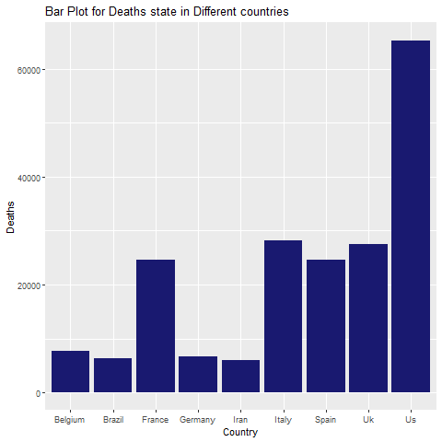
Bar Plot 1

Slide 21
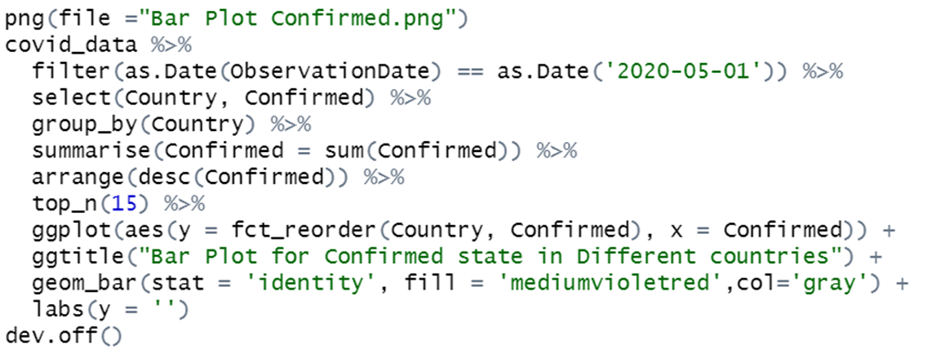
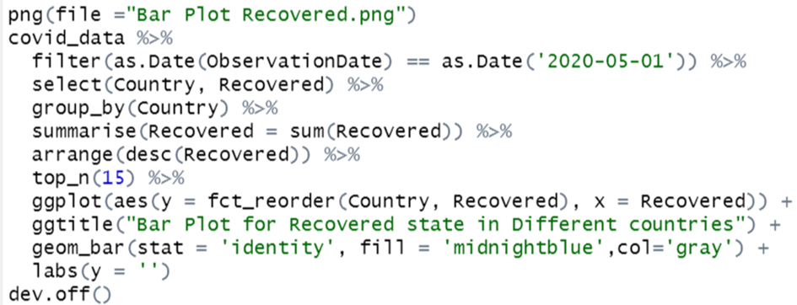
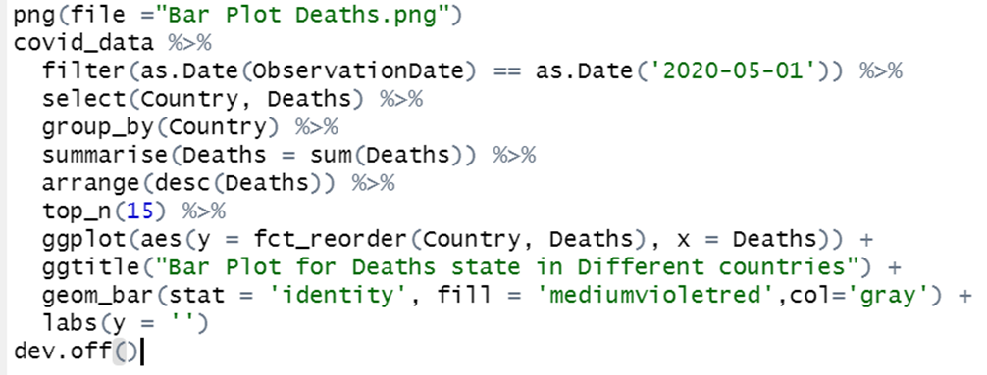
Bar Plot 2

Slide 22
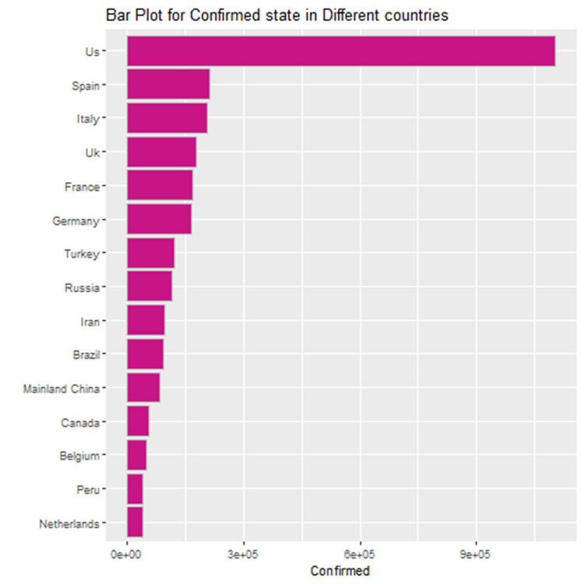
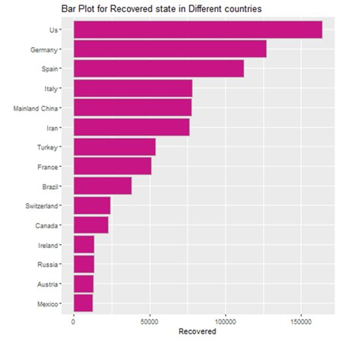
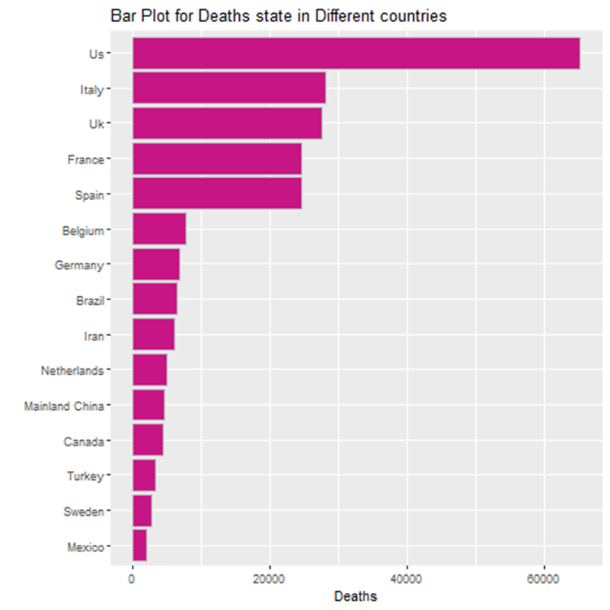
Bar Plot 2

Slide 23
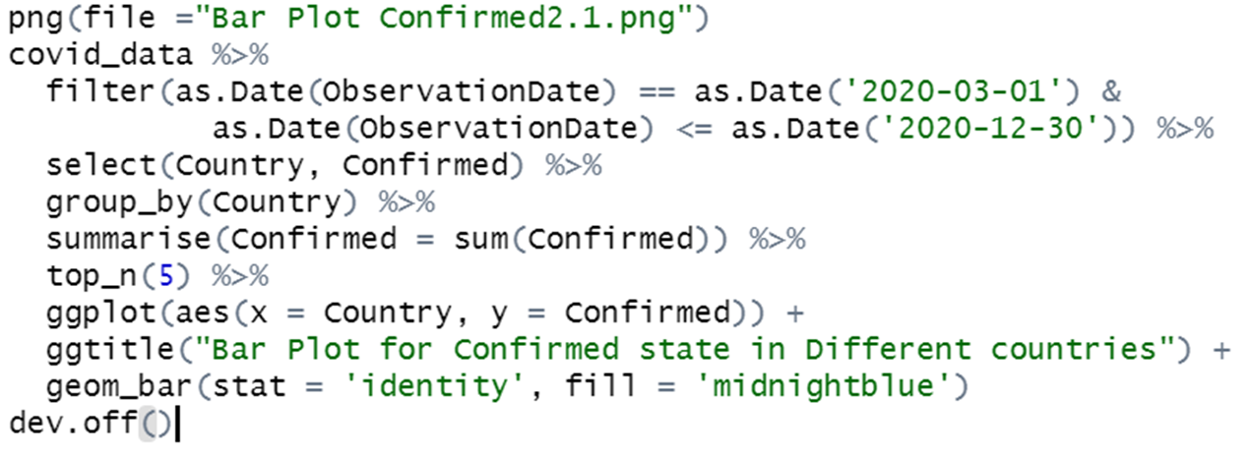
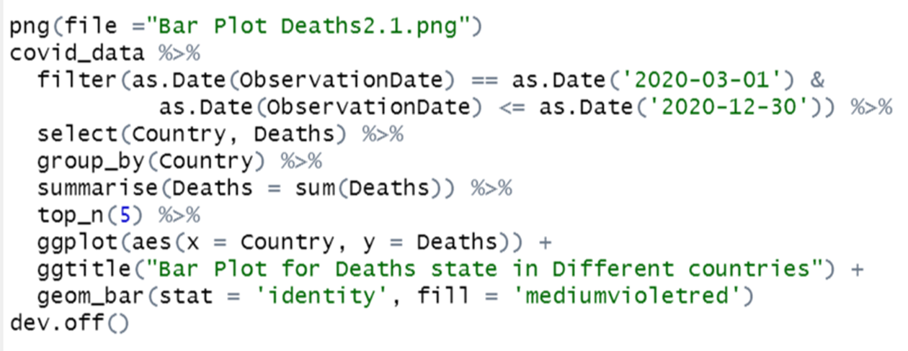
Bar Plot 3

Slide 24
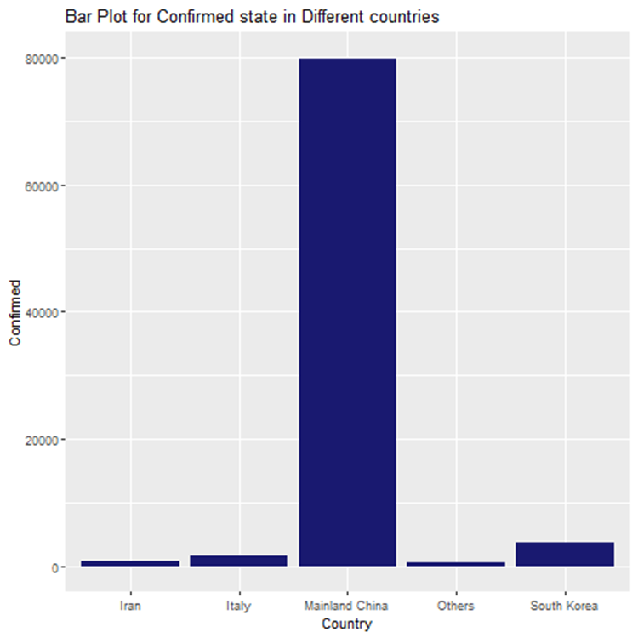
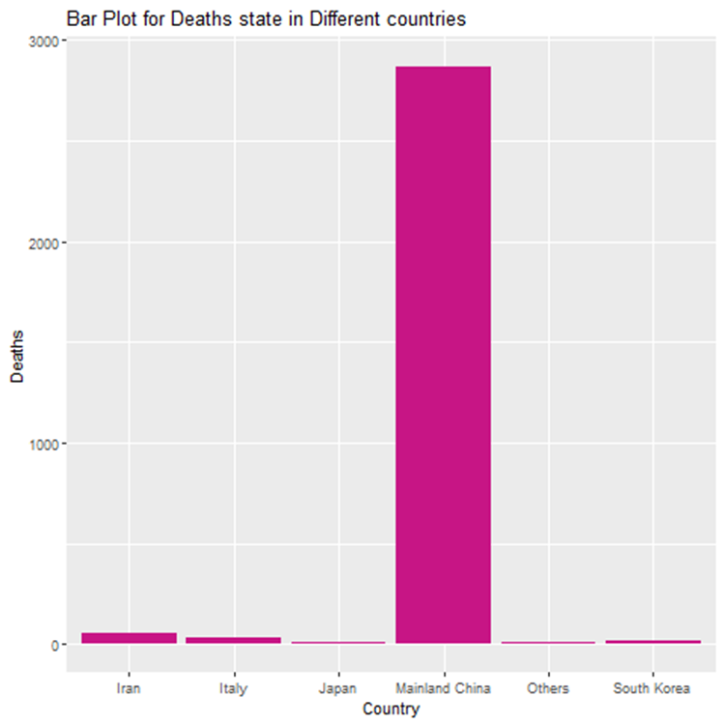
Bar Plot 3

Slide 25
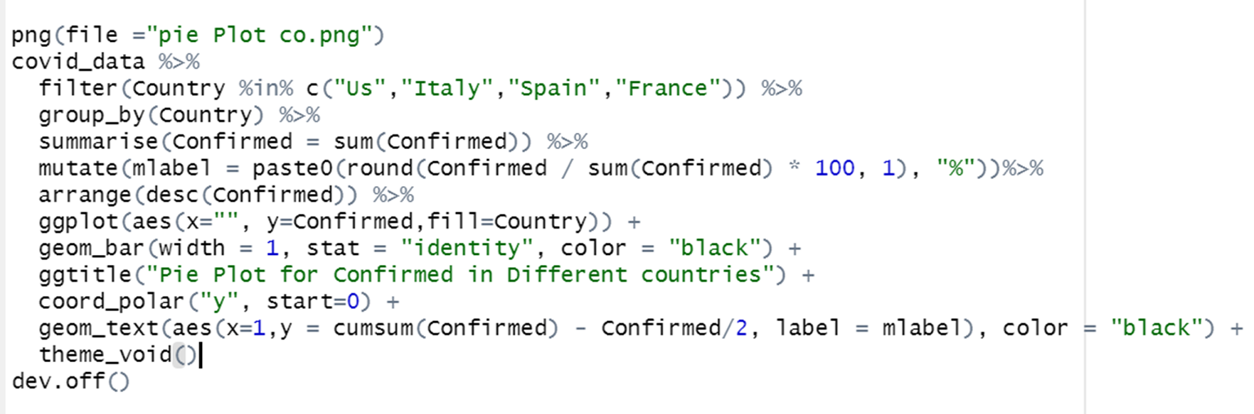
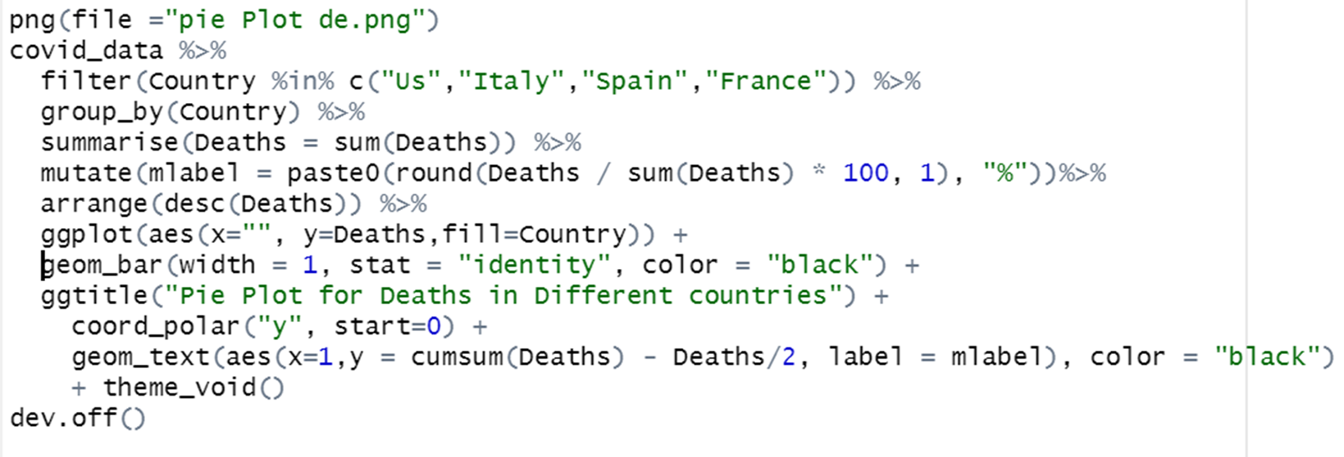
Pie Plot 1

Slide 26
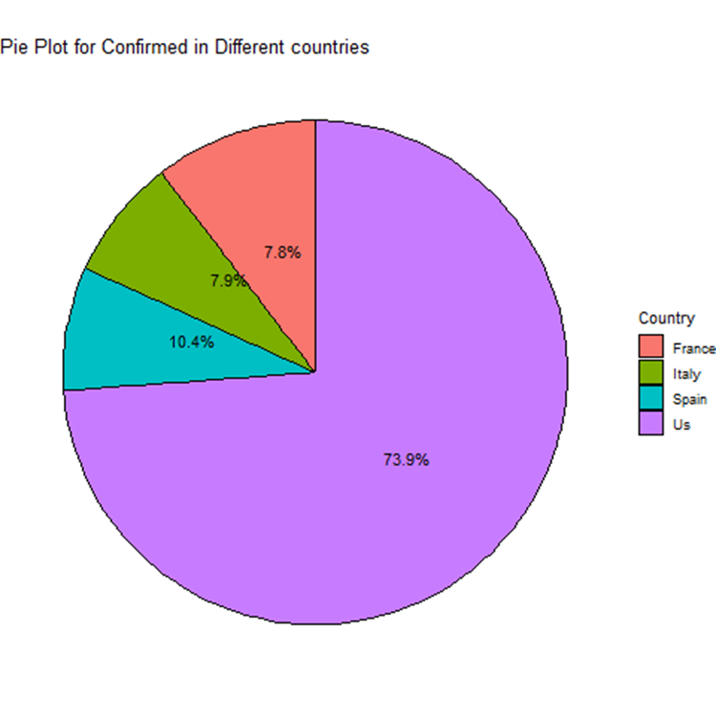
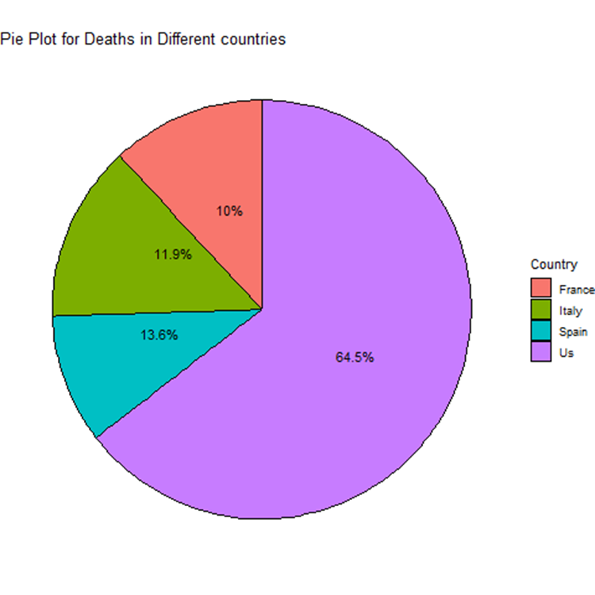
Pie Plot 1

Slide 27
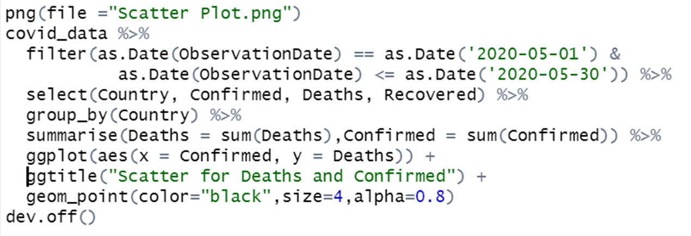
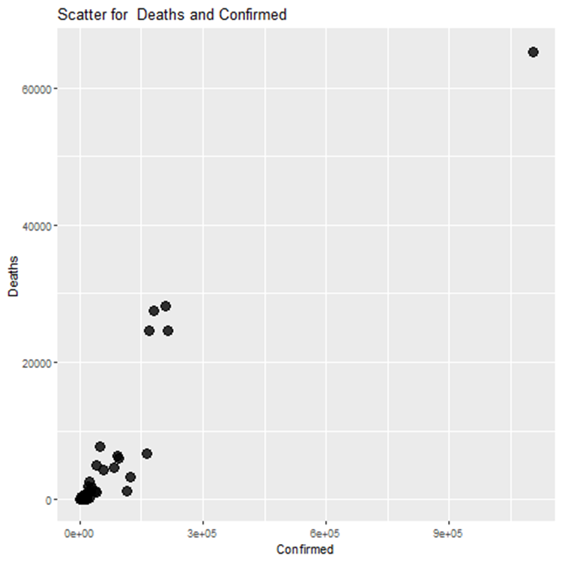
Scatter Plot 1

Slide 28
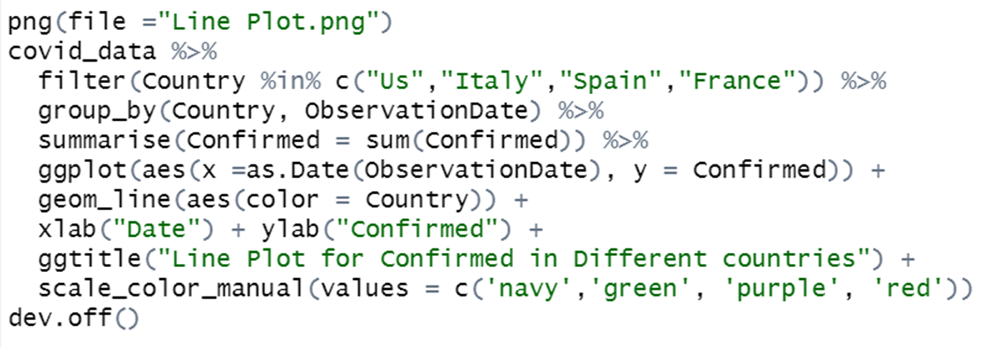
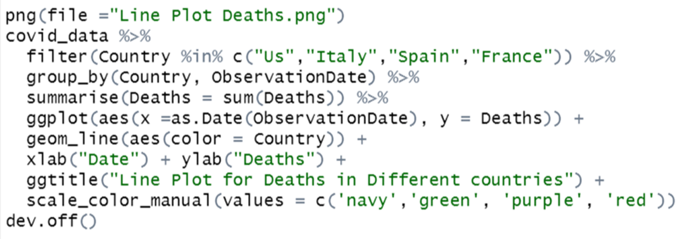
Line Plot 1

Slide 29
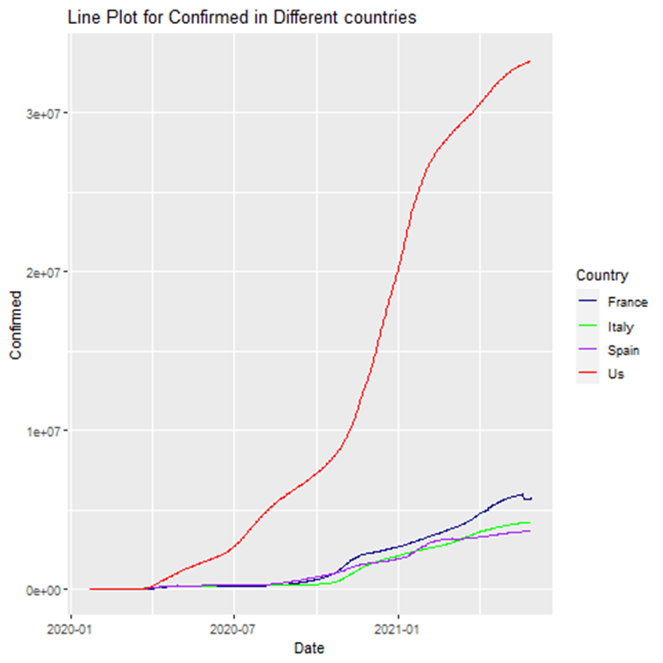
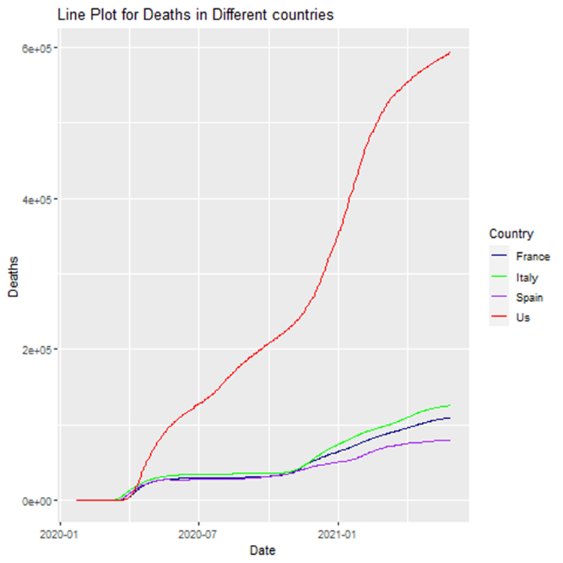
Line Plot 1

Slide 30
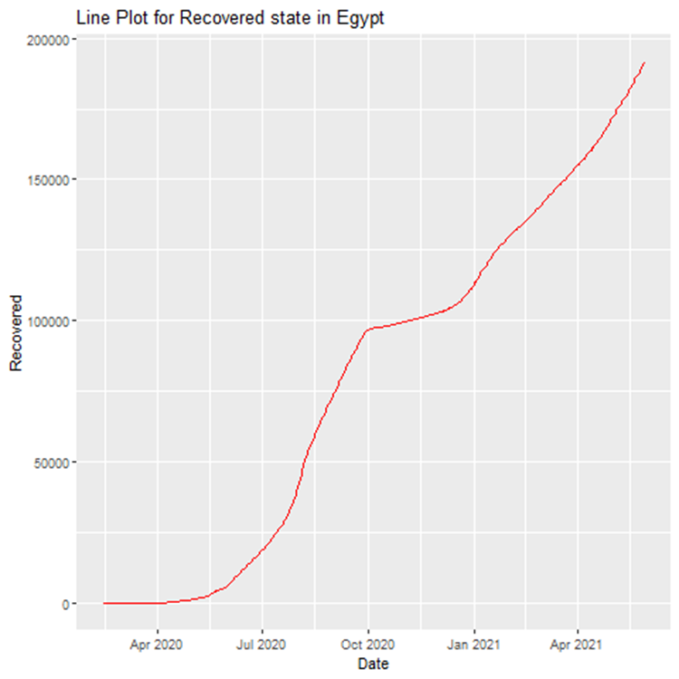
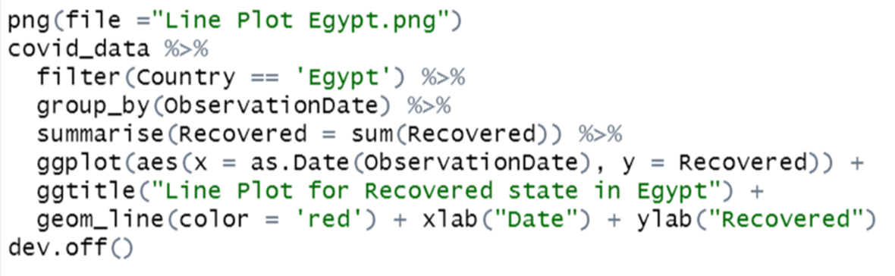
Line Plot 2

Slide 31
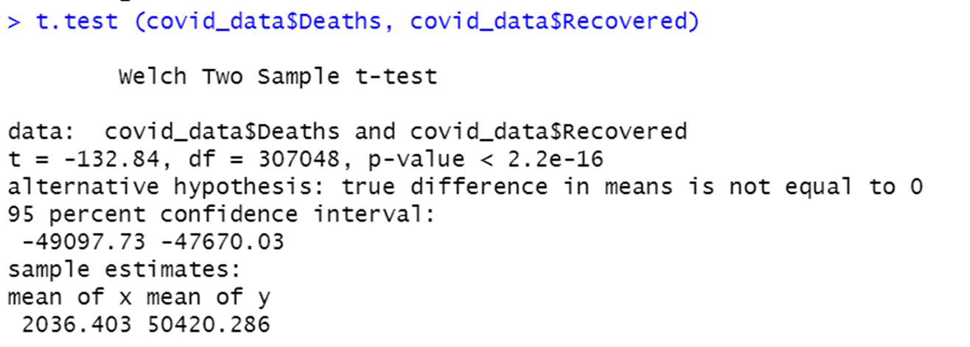
T-Test

Slide 32

Ontology

Slide 33
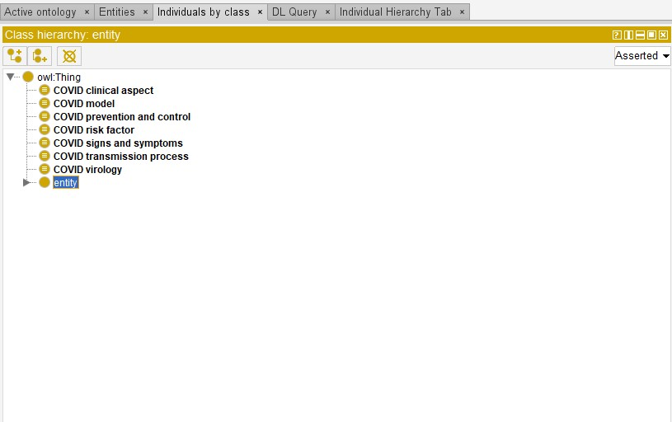
Main Ontology Classes

Slide 34

Some of the SubClasses of the Ontology

Slide 35

Instances for Covid Prevention And Control class

Slide 36

Instances of Covid Signs And Symptoms class

Slide 37

Diabetes is an Instance of Covid Risk Factors class. It has Object property assertion named (isRiskFactorFor) and has Object property assertion named (How_Risky =14%)

Slide 38

Older_age is an Instance of Covid Risk Factors class. It has Object property assertion named (isRiskFactorFor) and has Object property assertion named (How_Risky =60%)

Slide 39

Object Properties

Slide 40

Data Properties

Slide 41

Annotation Properties

Slide 42

individuals

Slide 43

RightField

Slide 44

Annotation

Slide 45

Direct subclasses of Thing class

Slide 46

Thing subclasses

Slide 47

Direct instances

Slide 48

Instances

Slide 49

Identify attribute

Slide 50


